Slide 1
Personalized Coaching & Therapy
Preventive care coaching
Quit smoking
Get fit
Lose or gain weight
Nutrition
Mental health
Manage depression (therapy): Woebot, Wysa
Manage stress (mindfulness): Mindcurrent.io
Companionship (elder care, teen care): Xiaoice

Slide 2
Pharmaceuticals
Designer molecules
Off-label discoveries
Exercise pill (2019 Salk)
Pharma co-vigilance
Monitoring social networks with NLP
Mining clinical medical records with NLP

Slide 3
Diagnostics
Internal medicine
Kidney disease (UK 2016)
Cancer
Melanoma (UK 2019)
Lung cancer (Stanford 2015)
Radiology
Pneumothorax (Kaggle 2019)

Slide 4
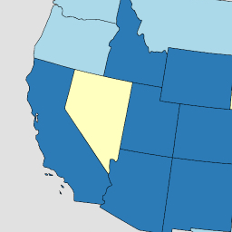
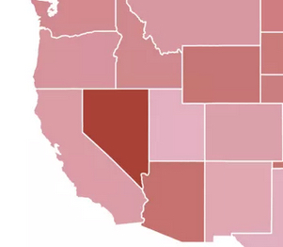
Smoking → Lung Disease
Lung & Bronchus Death Rates
(per 100,000)
6
28
3
California
Nevada
Utah
2243
19
Daily smokers
X
Y
Smoking
Cancer
28%
43
19
4%
19
99.98% Correlation
2% P-value
6%
22

Slide 5
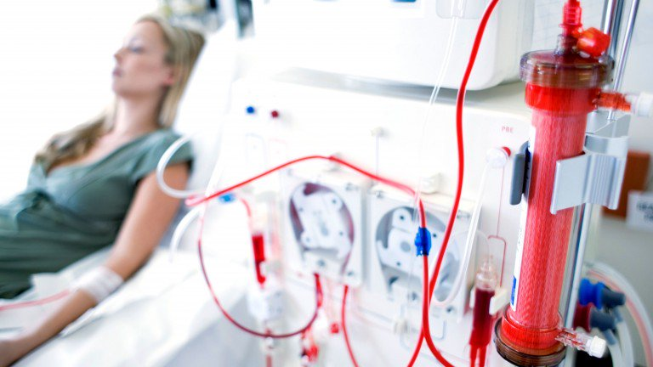
Example Application: Predict Kidney Disease
Clinical records can predict Kidney failure
2 days in advance
55% accuracy for acute problems
90% accuracy for serious issues
Dataset:
100% UK citizens
100% military
90% male
DeepMind (London)

Slide 6
Bayes Rule
Updated Probability = Likelihood Ratio x Prior Probability
$P\left(D|T\right)=\frac{P\left(T|D\right)}{P\left(T\right)}×P\left(D\right)$

Slide 7
Bayes Rule Example
Prior | P(D) | Probability of getting breast cancer | 1 in 700 per yr 1 in 70,000 (men)
True Positive Rate (Sensitivity) | P(T|D) | Probability of mammogram detecting cancer | .73
False Positive Rate (False Alarm) | P(T|~D) | Probability of positive mammogram w/o cancer | .12
Positive Rate | P(T) = P(D) * P(T|D) + P(~D) * P(T|~D) | Probability of a positive mammogram among all women | .73 * 1 / 700 + .27 * 699 / 700 = .121

Slide 8
Real Numbers
P(D) | 1/700
P(T|D) | .73
P(T) | .121
$P\left(D|T\right)=\frac{P\left(T|D\right)}{P\left(T\right)}×P\left(D\right)$
$P\left(D|T\right)=\frac{.73}{.121}×\frac{1}{700}=.0086≈1\text{\%}$

Slide 9
Deep Learning
Regression works for small numbers of “features”
Regression can be distracted by spurious correlations
Feature engineering is the hardest part of Data Science
What if we layered regressions on top of each other to create a “deeper” model?

Slide 10
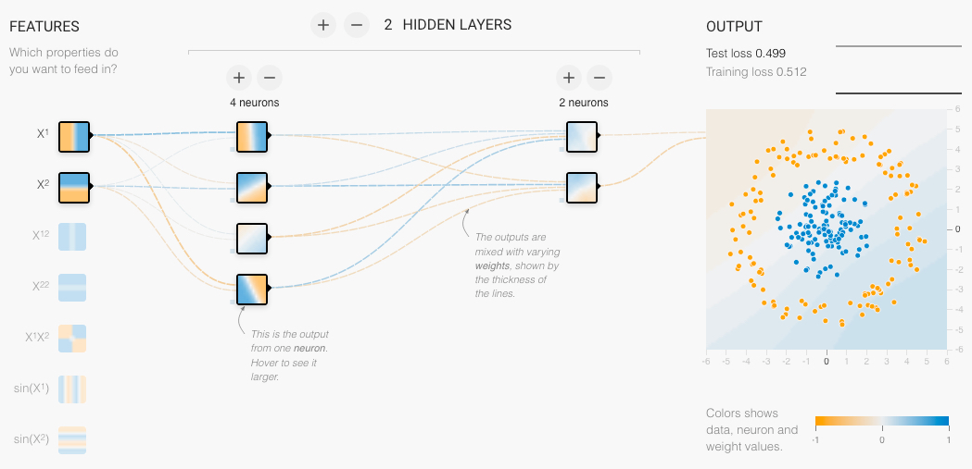
Neural Network
Neural Net Playground: bit.ly/ucsdnet

Slide 11
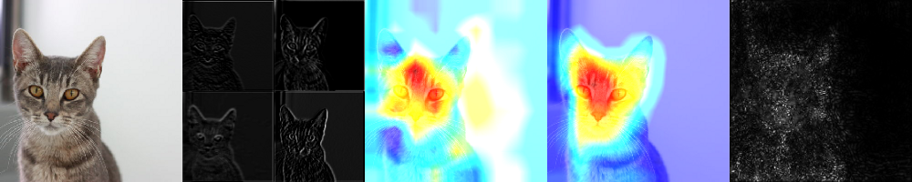
Explainability
Image
Activations
Importance
(Occlusion Sensitivity)
Grad CAM
(Gradient-weighted Class Activation Map)
SmoothGrad
Grad CAM: bit.ly/ucsdcam
tf-explain: bit.ly/ucsdexplain
SmoothGRAD: bit.ly/ucsdsmooth

Slide 12
Assignments

Slide 13
Quiz
Give two applications of Data Science to Health care
How is Deep Learning applicable to Health care?
Will Artificial Intelligence replace doctors?
Why or why not?
If a blood test for a particular disease has a False Positive rate of 10% and a False Negative rate of 30%, what’s the test’s precision (positive predictive value) and recall (sensitivity)?
Notes:
12

Slide 14
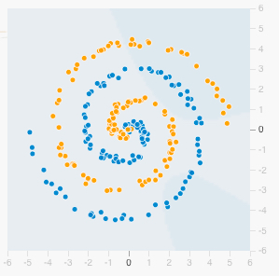
Homework: Play with Neural Nets
Visit playground.tensorflow.org
Select the spiral dataset and add 20% Noise
Add and remove different combinations of features: x1, x2, x1^2, x2^2, x1*x2, sin(x1), sin(x2)
Play around with different numbers of “HIDDEN LAYERS” and neurons per layer.
How many features, hidden layers and total neurons do you need achieve < 15% test set loss?
Notes:
12

